Slide 1

Credit Card Fraud Detection
Protecting financial transactions from fraudulent activities using machine learning models.

Slide 2

Fraud Definition
Unauthorized Use
Financial Loss
Illegal Activity
Using credit card details without permission
Leads to significant losses for cardholders and institutions
Fraudulent transactions are considered a criminal offense
Solution Approach
A hybrid strategy is chosen among the models examined, which include Regression-based classifiers, Decision Tree classifiers, and Boosting based models. This hybrid method optimizes using a grid-based searching algorithm and combines a tree-based model with a linear-based model. The models are optimized to maximize performance on the given dataset. The training of the trees by gradient boost technique is optimised by the use of XG Boost which is an Extreme Gradient Boosting algorithm

Slide 3

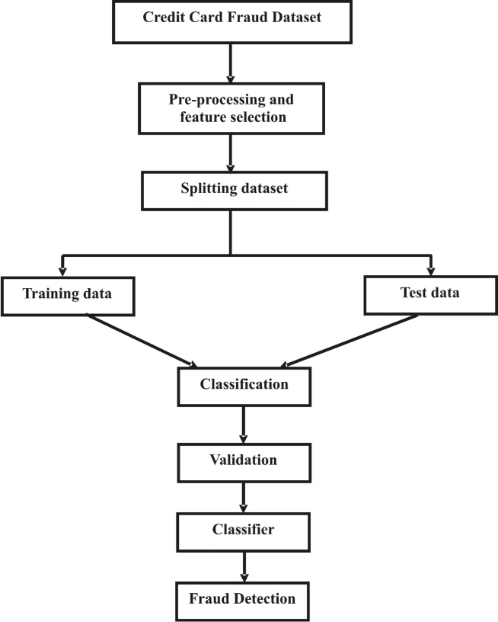
Fraud Detection Techniques
1
Data Analysis
Examine transaction patterns and customer behavior
2
Data Processing
Preparing the dataset by splitting them into training and testing data
3
Machine Learning Models
Train classifier models to identify suspicious activities
4
Real-time Monitoring
Continuously monitor transactions for fraud alerts

Slide 4
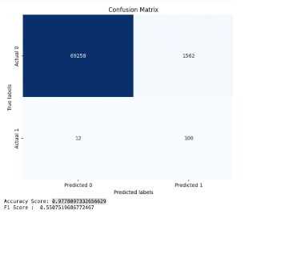
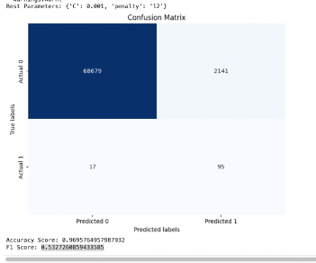
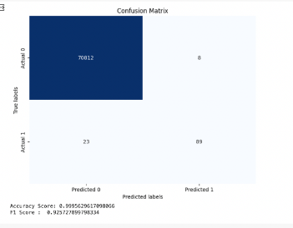
Predictive Modeling
Logistic Regression
Random Forest
Grid Search Logistic Regression
Predicts fraud probability using transaction data
Ensemble method to detect complex fraud patterns
Gradient boosting algorithm for high accuracy
The accuracy score of the Logistic Regression model is 0.9778 and the F1 Score is 0.55075.
The accuracy score of the Random Forest Classifier model is 0.9995 and the F1 Score is 0.9257
The accuracy score of the Grid Search based Logistic Regression model is 0.9695 and the F1 Score is 0.5327
.

Slide 5
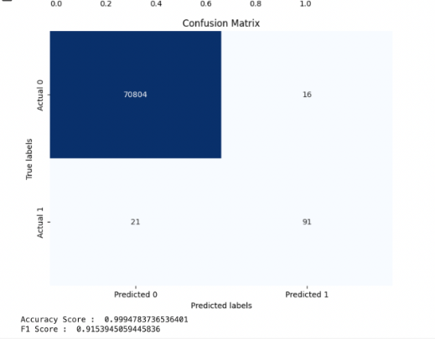
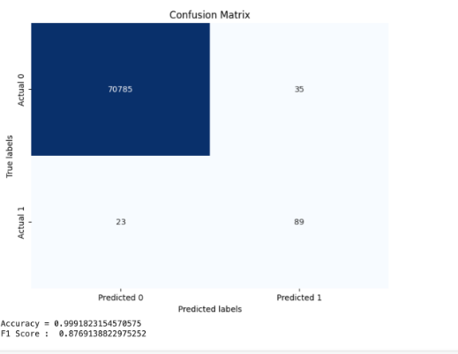
Boosting Techniques to tune the Models
XGBoost
Categorical Boost
A Hyperparameter which predicts fraud probability using transaction data
Ensemble method to detect complex fraud patterns
The accuracy score of the Xgboosting Classifier model is 0.9994 and the F1 Score is 0.9153.
The accuracy score of the Catboost Boosting Classifier model is 0.9991 and the F1 Score is 0.8769.
.
.

Slide 6

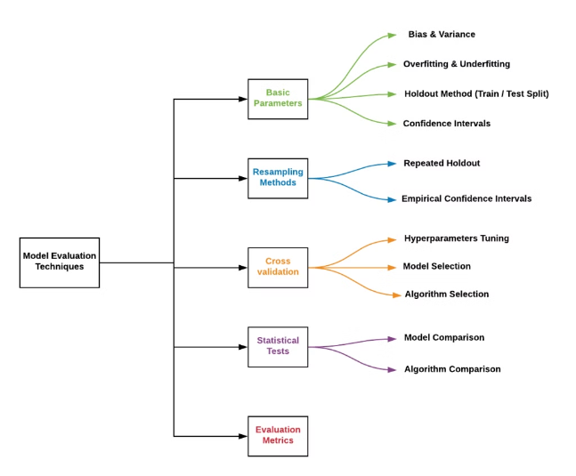
Evaluation Metrics
1
Accuracy
Overall correctness of fraud predictions
2
F1 Score
Harmonic mean of precision and recall
3
ROC-AUC
Measure of model's discrimination ability

Slide 7
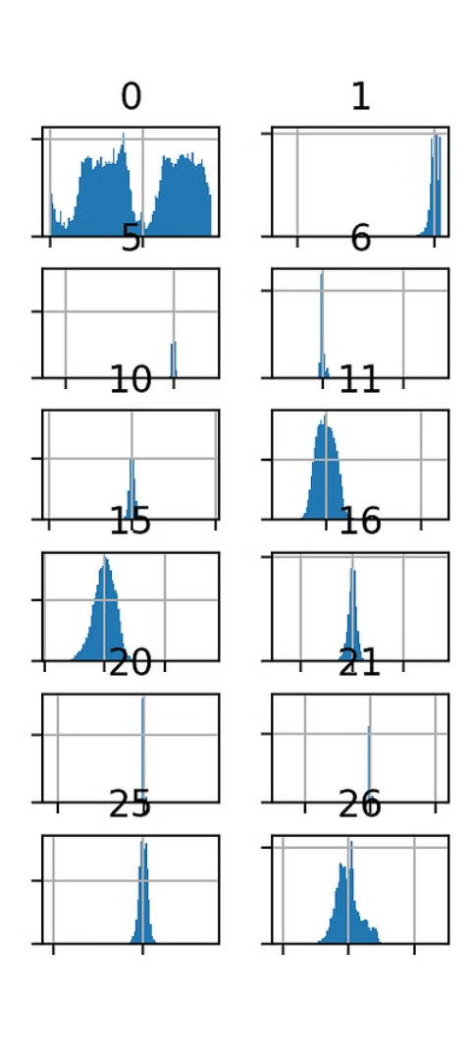
Handling Imbalance
Oversampling
Undersampling
Generate synthetic samples of minority class
Remove majority class samples strategically
SMOTE (Synthetic Minority Over-sampling)
SMOTE helps to balance the distribution of such imbalanced data by creating data points for the minority class.
SMOTE also reduces the chance of overfitting while simultaneously increasing the size of the data set

Slide 8




Optimization Techniques
Grid Search
Exhaustive search for optimal parameters
Grid search is a popular machine learning technique that goes through different values of parameters and then selects the best out of them. It is a hyperparameter tuning technique that is used to find the best parameter for a specific model.
Regularization
L1 and L2 regularization prevents overfitting and improve generalization
Ensemble Methods
Combine multiple models for better performance

Slide 9
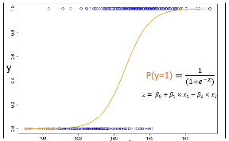
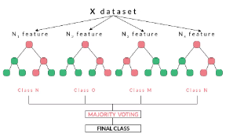
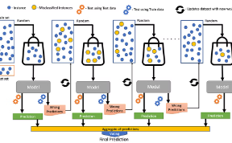
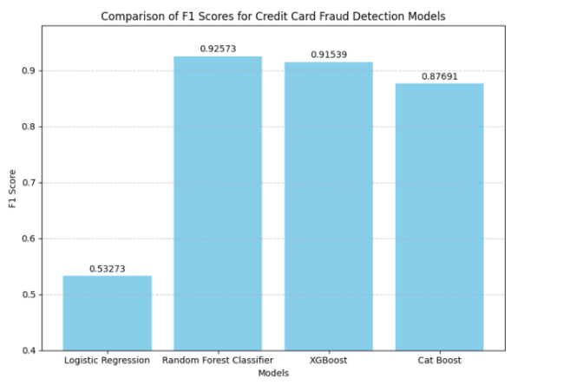
Model Comparison
Logistic Regression
Random Forest
XGBoost
Efficient for binary classification
Robust to outliers and noise
Highly accurate and scalable

Slide 10




Real-world Impact
Secure Transactions
Financial Savings
Increased Trust
Protects customers and businesses
Reduces losses from fraudulent activities
Builds confidence in digital payments

Slide 11

Future Developments
Blockchain
Enhance security and transparency
Deep Learning
Improve pattern recognition capabilities
Behavioral Analytics
Detect anomalies in user behavior

Slide 12
Thank You

